Slide 1
CoCo
Collaborative Collections
Austin Chustz, Jeff Garnier, Tom Kremer

Slide 2
Presentation Overview
3 Tasks
Key Changes
Revised UI Design
Live Demo
Tools Used
Recap

Slide 3
Three Different Tasks
Task 1: Capture and share content
Also attending events
Task 2: View and vote on submitted content
Task 3: Share finished collections of content

Slide 4
Three Tasks and Key Changes
Task 1: Confusion about home screen and how to share content
Also wanted to be able to not attend
Task 2: Confusion about categories of events
Task 3: No serious changes

Slide 5
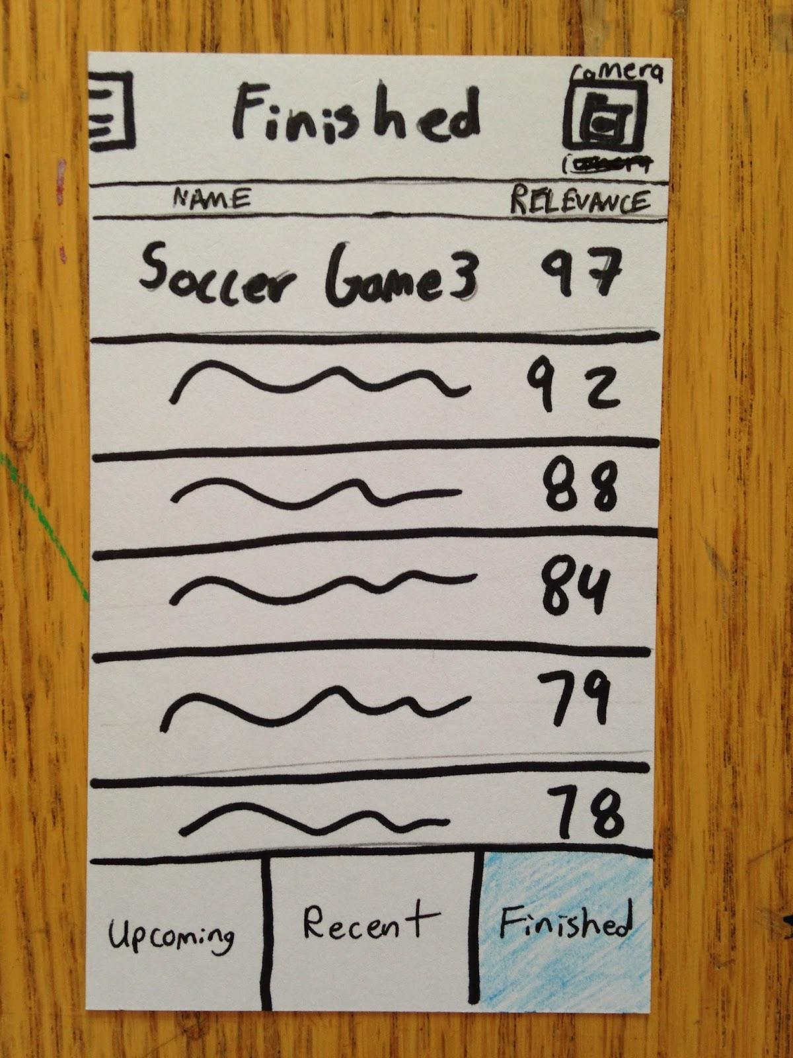
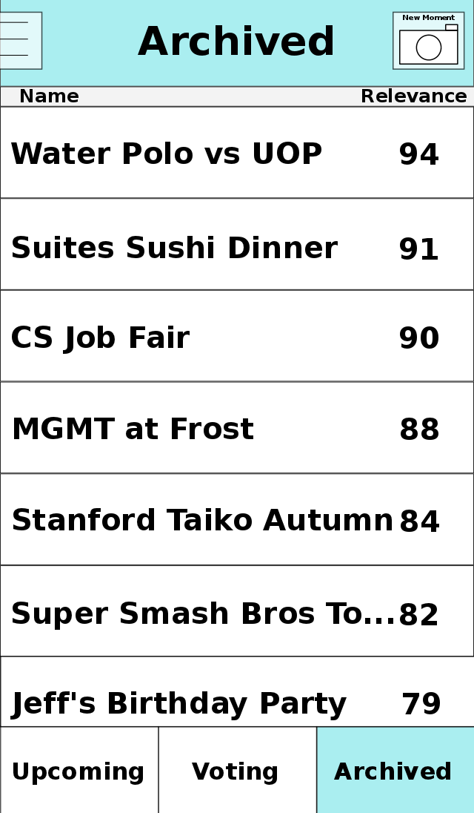
Revised UI Design

Slide 6
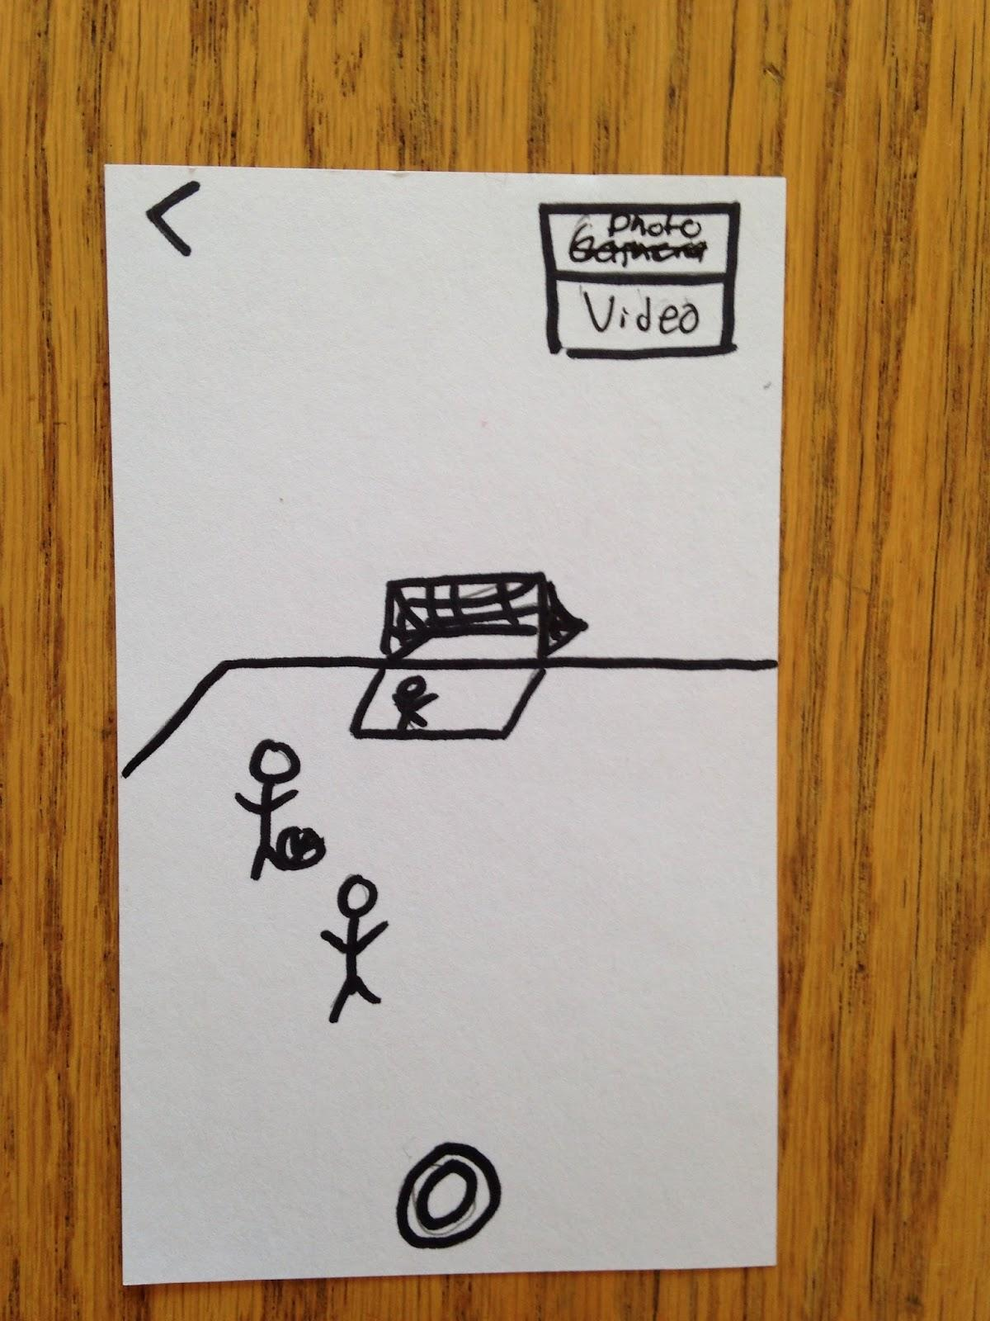
Revised UI Design

Slide 7
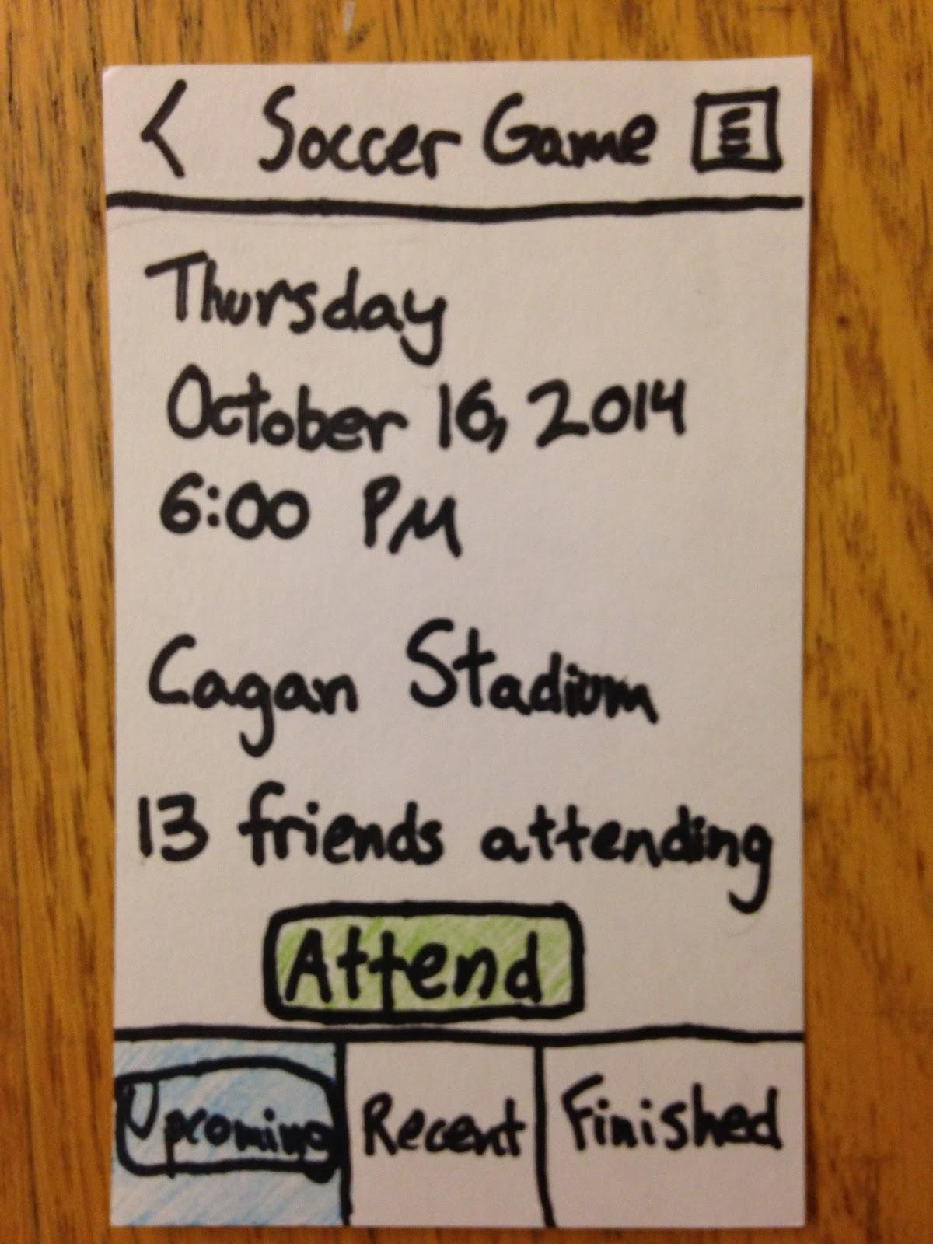
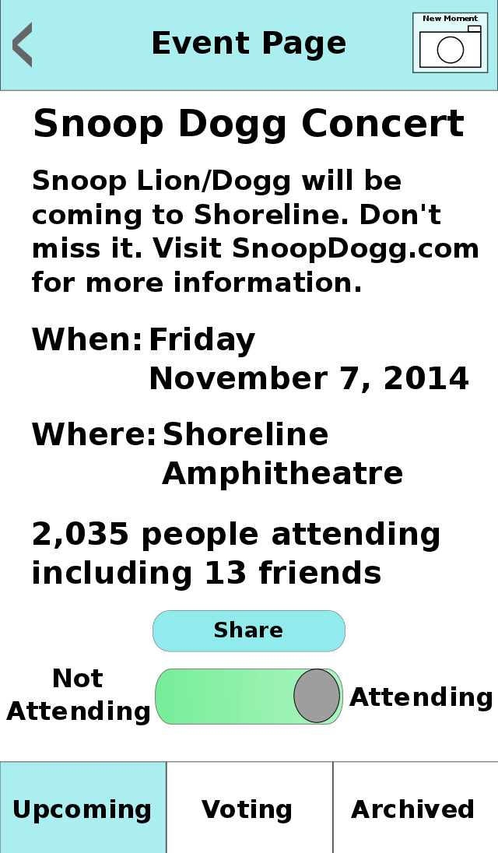
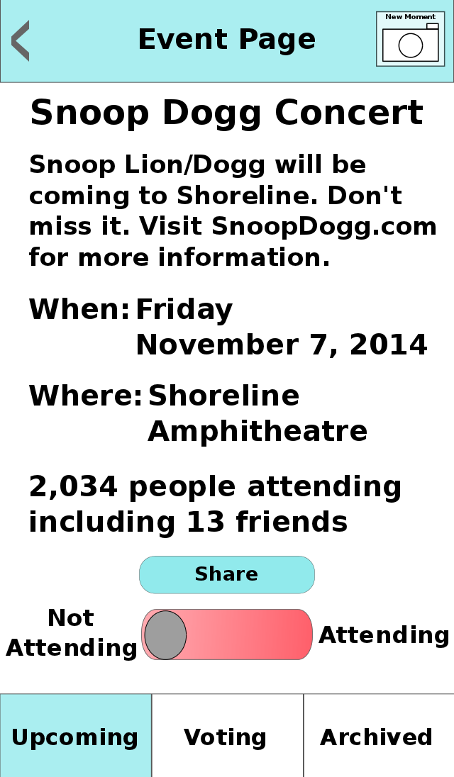
Revised UI Design

Slide 8
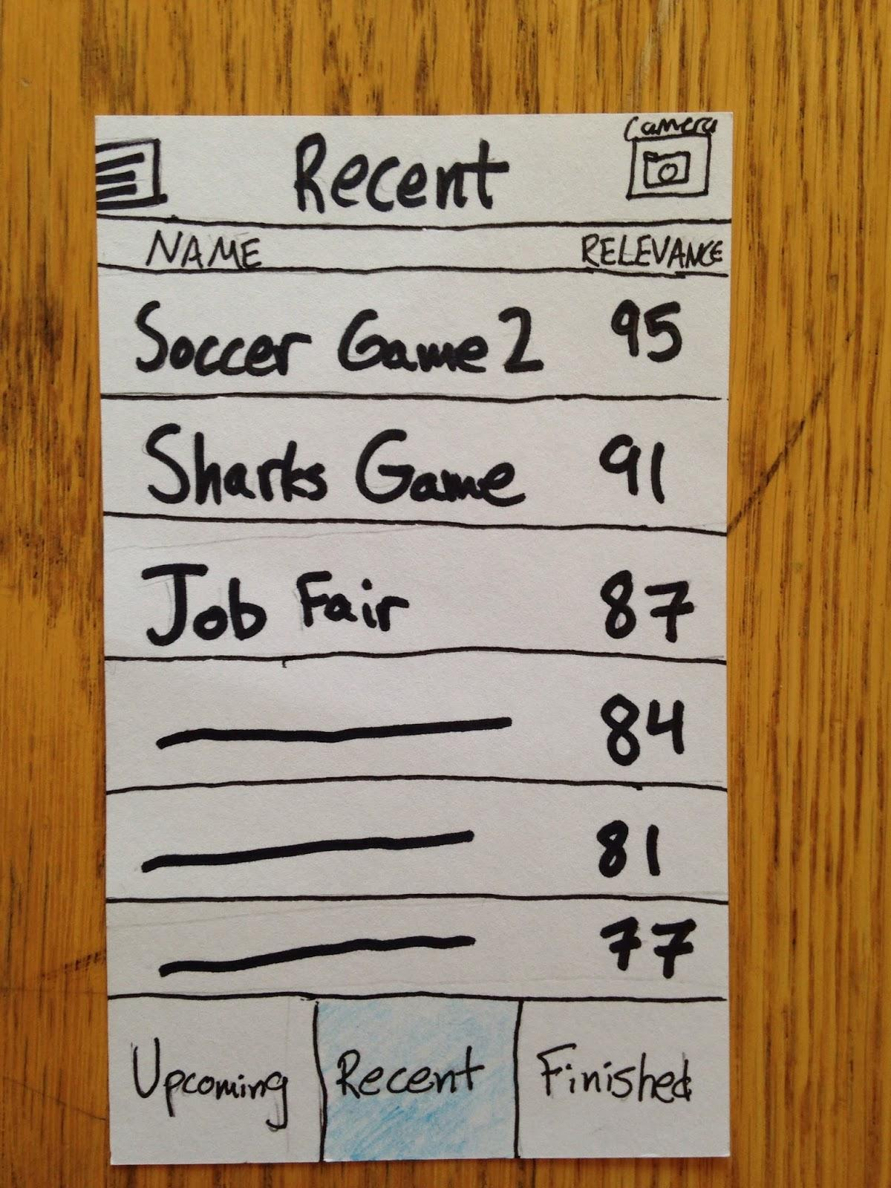
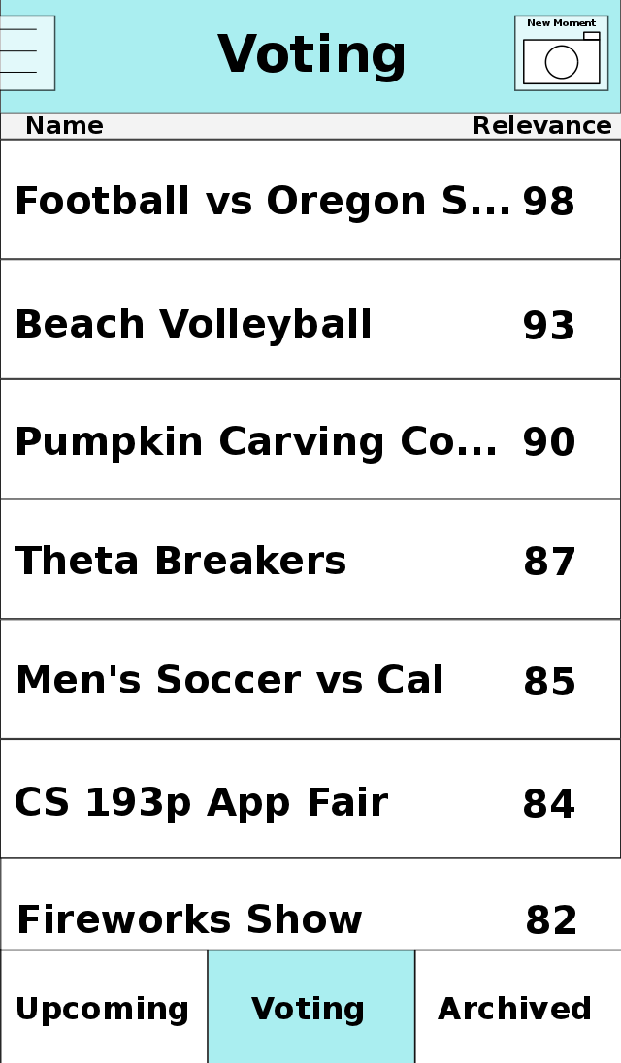
Revised UI Design

Slide 9
Live Demo
CoCo Demo

Slide 10
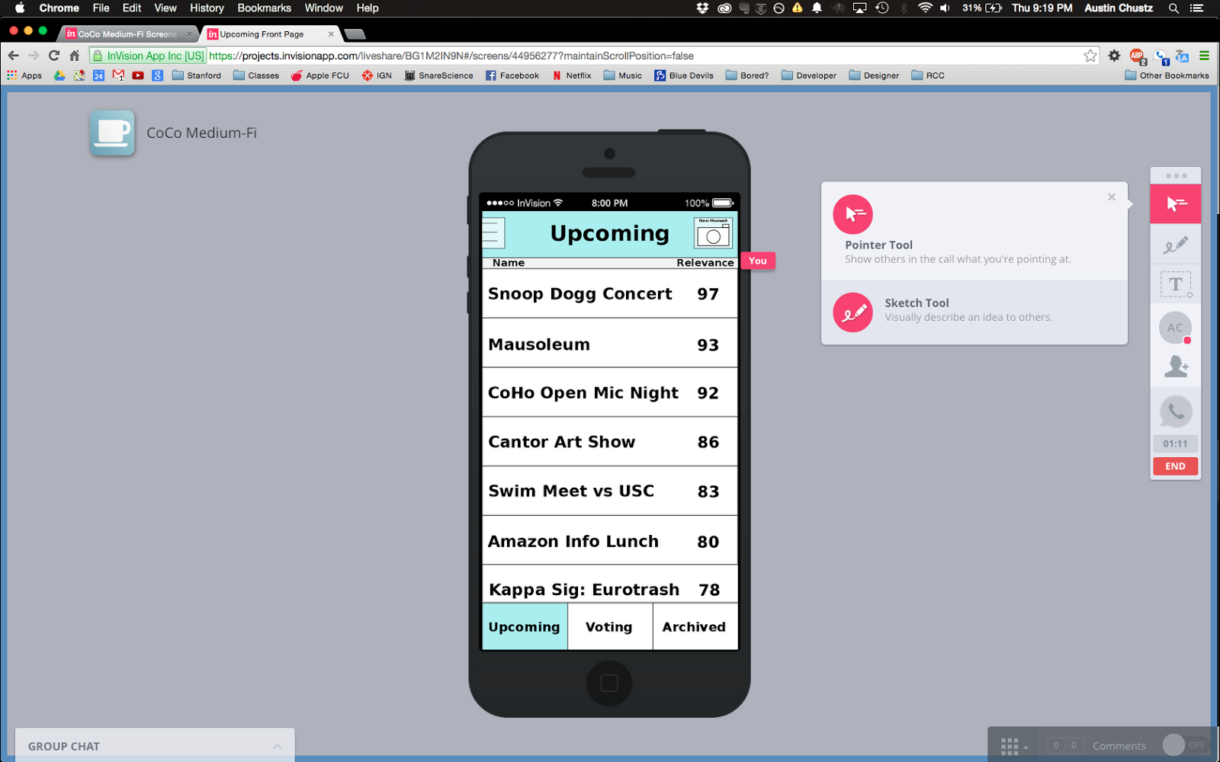
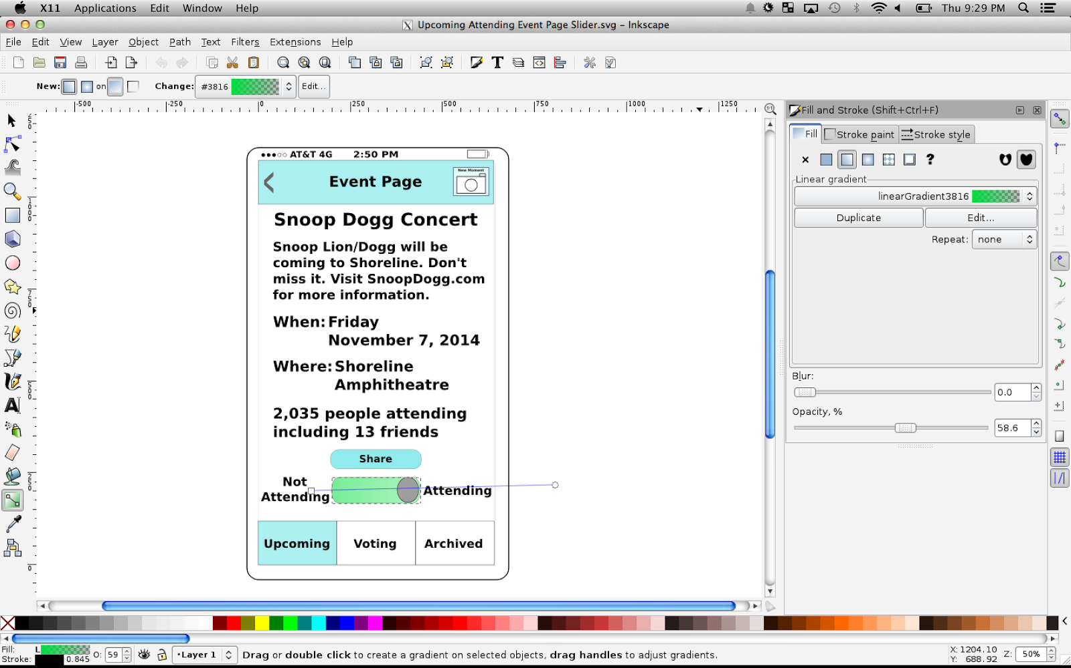
Tools Used

Slide 11
What Worked What Didn't
App looks extremely legitimate
Easier to prompt user how to navigate
Cleaner, clearer look
Flexibility with fonts and sizes
Colors looks flat
No memory of user actions or different states
Difficult to employ multiple gestures

Slide 12
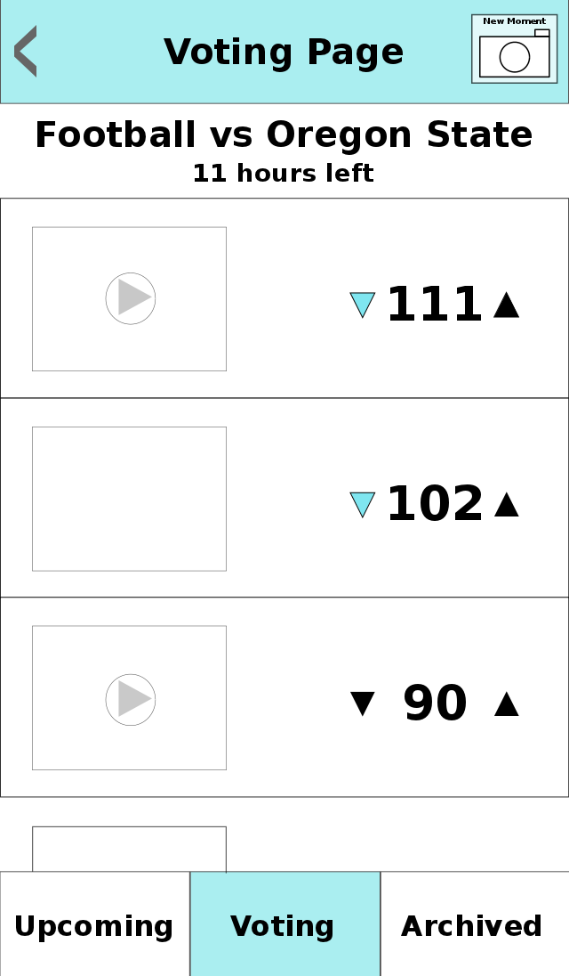
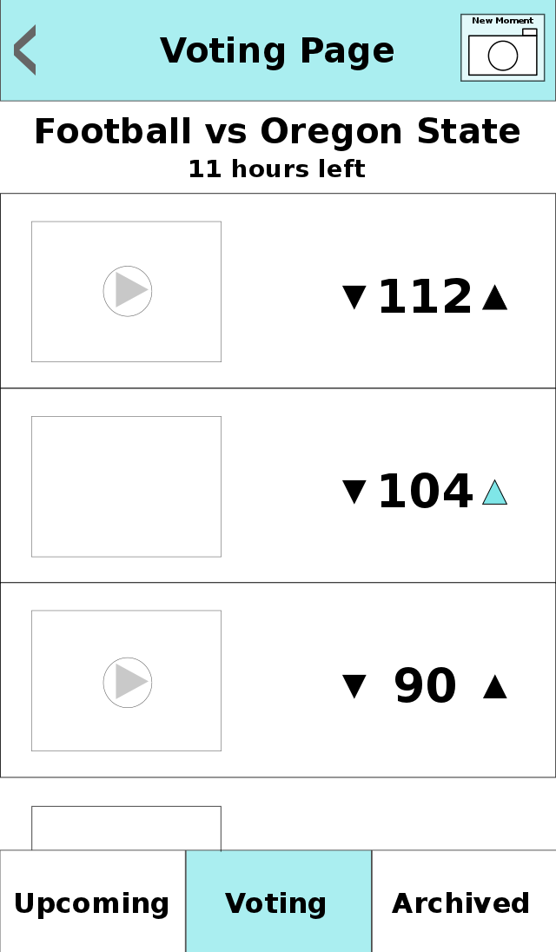
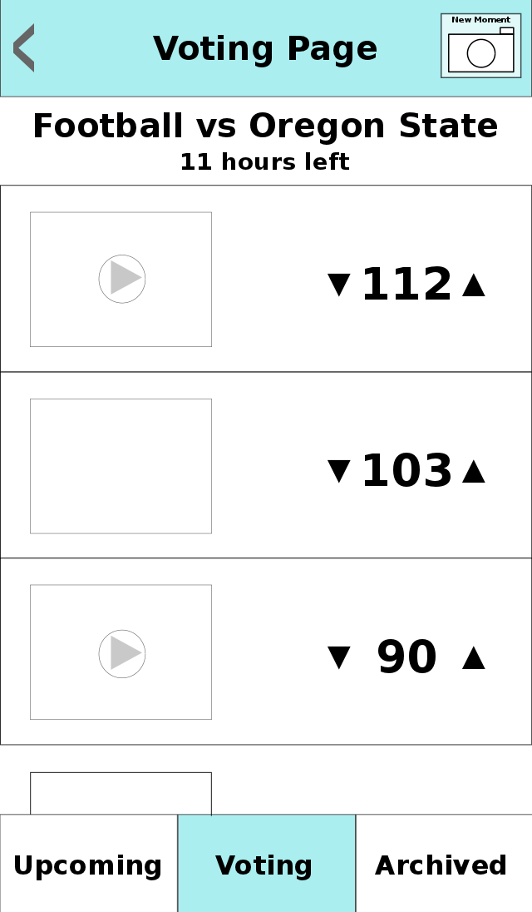
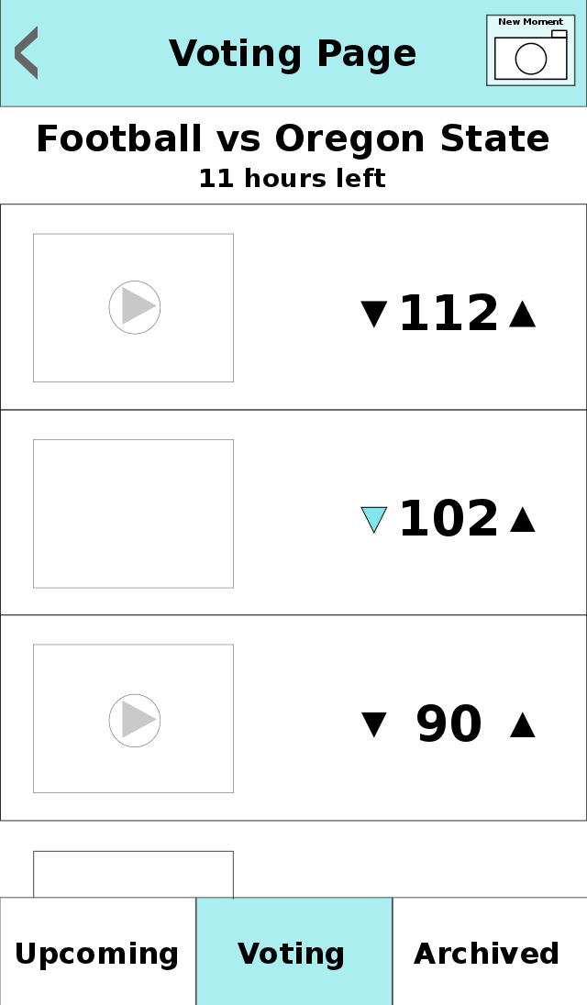
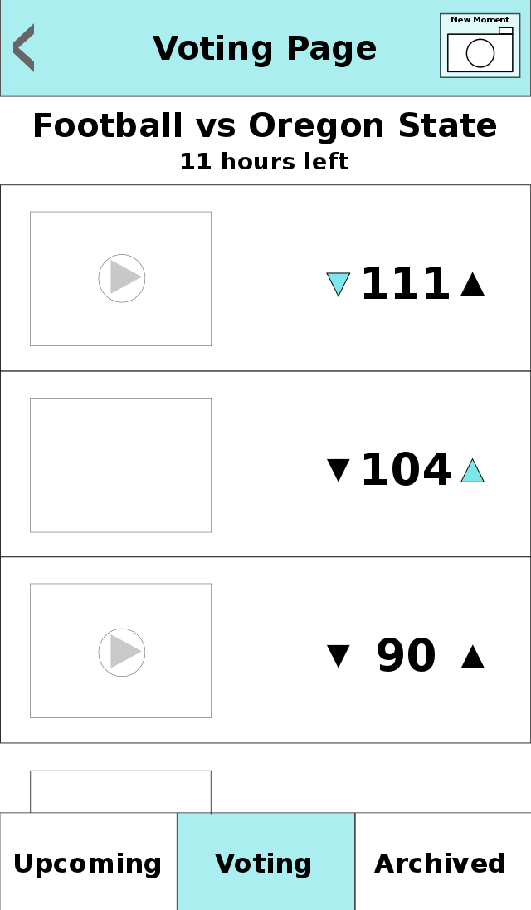
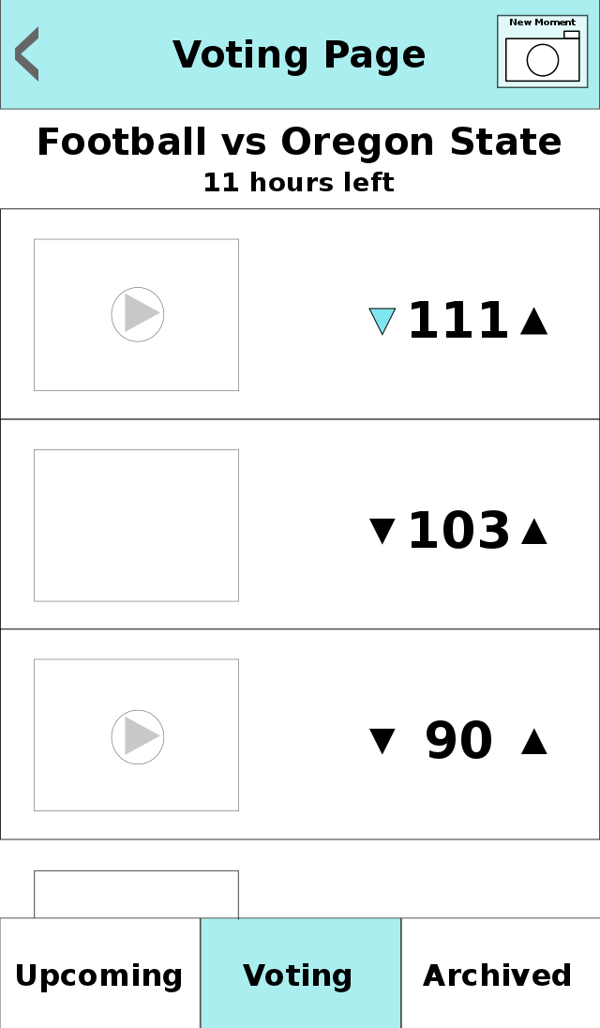
Wizard of Oz Techniques
Not really a back button

Slide 13
Summary
Three tasks and key changes
Changes to UI to simplify and improve user experience
Limitations of tools used

